Slide 1
Graph Theory

Slide 2
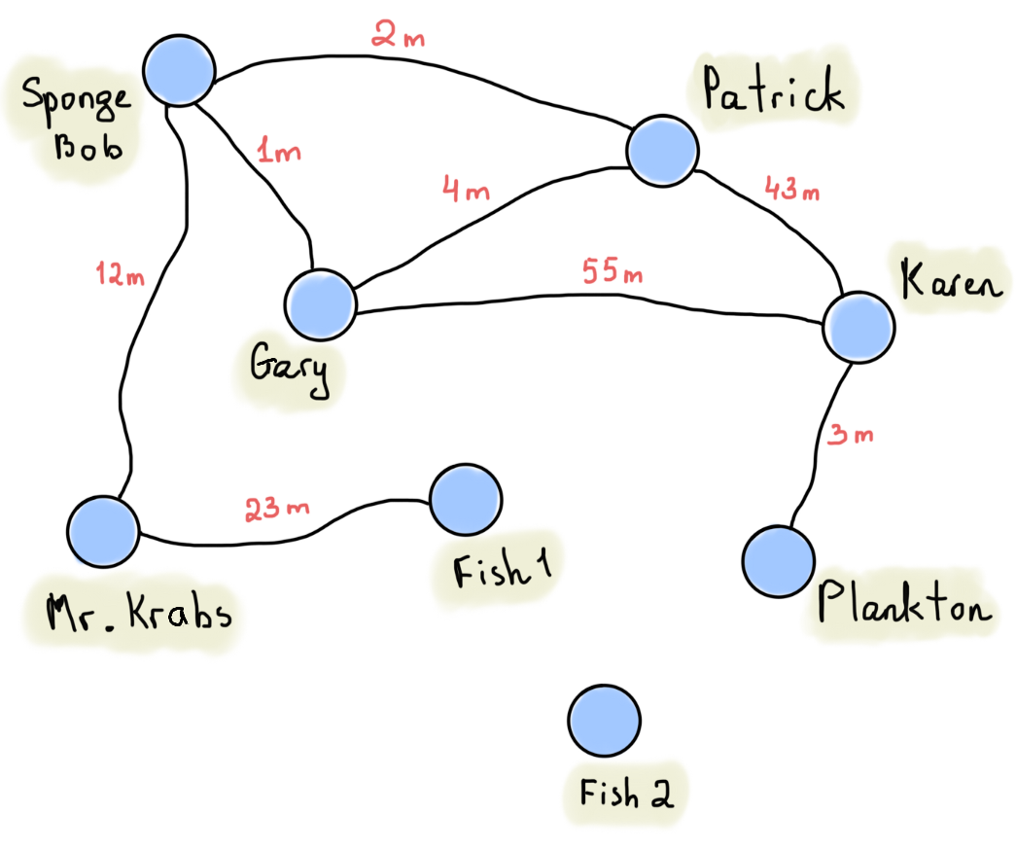
A walk is a finite or infinite sequence of edges which joins a sequence of vertices. (SB-P-SB-G-K-PL-K-P-SB)
A simple undirected weighted cyclic graph:

Slide 3
A trail is a walk in which all edges are distinct. (SB-G-P-SB-MK)
A simple undirected weighted cyclic graph:

Slide 4
A path is a trail in which all vertices are distinct. (SB-G-P)
A simple undirected weighted cyclic graph:

Slide 5
A cycle is a path which connects a vertex to itself. (G-P-K-G)
A simple undirected weighted cyclic graph:

Slide 6
Edges my repeat Vertices may repeat
Walk yes yes
Trail no yes
Path no no
Cycle = A path +
an edge that takes you back to the start

Slide 7
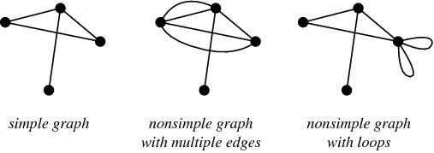
A simple graph doesn’t contain loops or multiple edges between nodes

Slide 8
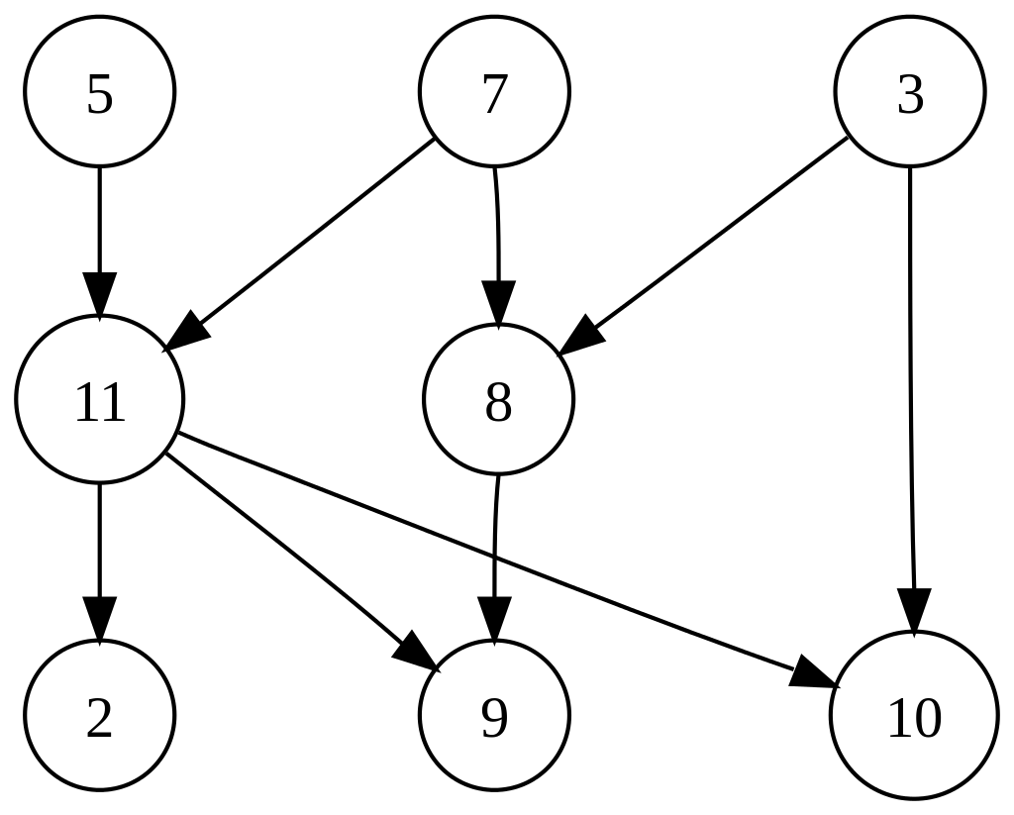
A simple directed graph has no multiple arrows with same source and target nodes.
A simple directed acyclic graph:

Slide 9
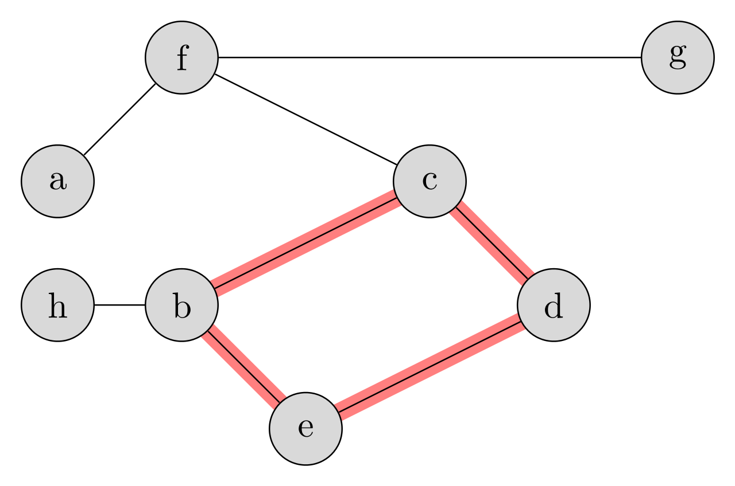
A cyclic graph has at least one cycle.

Slide 10
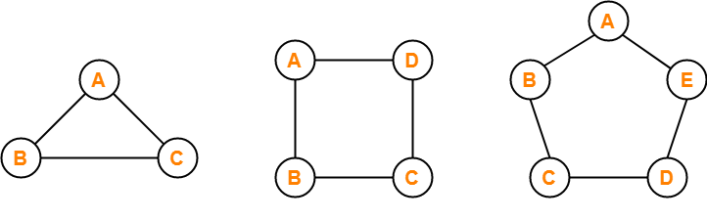
A cycle graph / circular graph is a cycle.

Slide 11
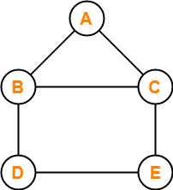
Consider the following graph:
In this graph, few examples of walk are:
a , b , c , e , d (Length = 4)
d , b , a , c , e , d , e , c (Length = 7)
e , c , b , a , c , e , d (Length = 6)

Slide 12
edges
distinct?
If an edge repeats, it must be only a walk.
just a Walk
vertices
distinct?
just a Trail
start=end?
just a Path
Cycle

Slide 13
A simple path is a path where each vertex occurs / is visited only once. Note that in modern graph theory this is also simply referred to as path, where the term walk is used to describe the more general notion of a sequence of edges where each next edge has the end vertex of the preceding edge as its begin vertex. A walk where each edge occurs at most once (as opposed to each vertex) is generally called a trail.

Slide 14
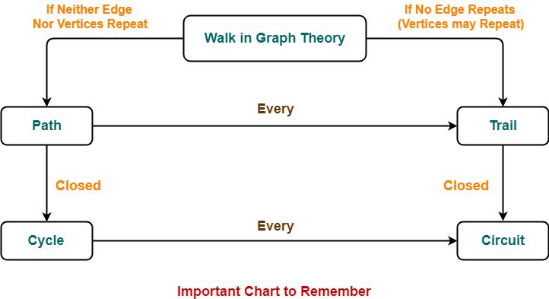

Slide 15
Graph Theory
In mathematics, a graph is a representation of a set of objects where some pairs of the objects are connected by links. The interconnected objects are represented by mathematical abstractions called vertices, and the links that connect some pairs of vertices are called edges. Typically, a graph is depicted in diagrammatic form as a set of dots for the vertices, joined by lines or curves for the edges. Graphs are one of the objects of study in discrete mathematics.

Slide 16
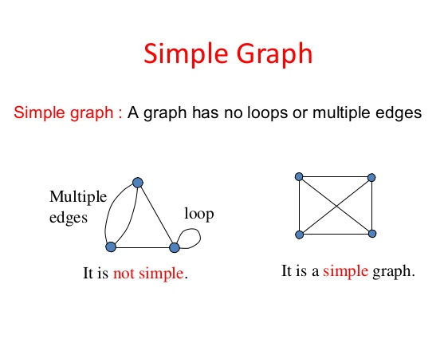

Slide 17
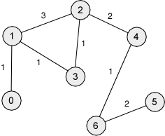
Graph Theory
A weighted graph associates a value (weight) with every edge in the graph.

Slide 18
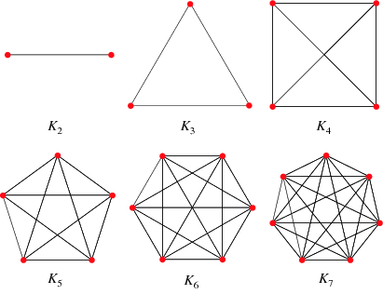
Complete Graph
A simple undirected graph in which every pair of distinct vertices is connected by a unique edge.
The complete graph on n vertices is denoted by K_{n}.

Slide 19
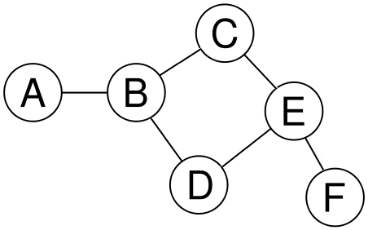
Undirected Graph
An undirected graph consists of a set of vertices together with a set of edges joining the verticies.

Slide 20
Adjacency Matrix for an Undirected Graph
An adjacency matrix can be used to representing which vertices (or nodes) of a graph are adjacent to which other vertices.
 | A | B | C | D | E | F
A | 0 | 1 | 0 | 0 | 0 | 0
B | 1 | 0 | 1 | 1 | 0 | 0
C | 0 | 1 | 0 | 0 | 1 | 0
D | 0 | 1 | 0 | 0 | 1 | 0
E | 0 | 0 | 1 | 1 | 0 | 1
F | 0 | 0 | 0 | 0 | 1 | 0

Slide 21
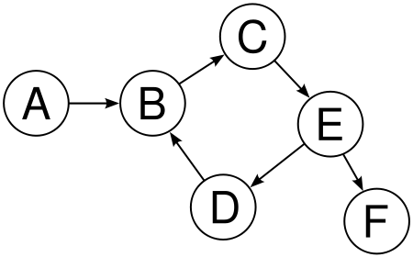
Directed Graph
A directed graph consists of a set of vertices together with a set of directed edges joining the verticies.

Slide 22
Adjacenty Matrix for a Directed Graph
An adjacency matrix can be used to representing which vertices (or nodes) of a graph are adjacent to which other vertices.
 | A | B | C | D | E | F
A | 0 | 1 | 0 | 0 | 0 | 0
B | 0 | 0 | 1 | 0 | 0 | 0
C | 0 | 0 | 0 | 0 | 1 | 0
D | 0 | 1 | 0 | 0 | 0 | 0
E | 0 | 0 | 0 | 1 | 0 | 1
F | 0 | 0 | 0 | 0 | 0 | 0

Slide 23
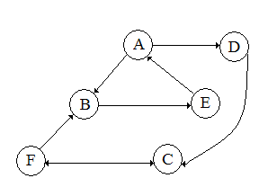
Graph Theory
A path is a sequence of vertices such that from each of its vertices there is an edge to the successor vertex.
AD
ABEA
DC

Slide 24
Graph Theory
A path is walk where none of the edges or vertices repeat.
AD
ABEA
DC
FBEADC

Slide 25
Graph Theory
A cycle is path where no vertices repeat except for the first and last vertices.
AD
ABEA
DC
FBEADC

Slide 26
Graph Theory
The length of a path is the number of edges that the path uses.
AD – length 1
ABEA – length 3
FBEADC – length 5

Slide 27
Graph Theory
How many walks of length 2 exists in this Adjacency matrix?
 | A | B | C
A | 0 | 1 | 1
B | 1 | 0 | 0
C | 1 | 0 | 0

Slide 28
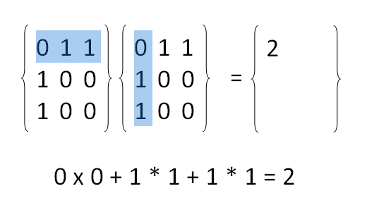
Matrix Multiplication

Slide 29
Questions?

Slide 30
Java
Object Oriented Programming
Begin Lab 01

Slide 31
Connected?
Repeats
edge?
Just a Graph,
like a quadrilateral with no special properties to make it a kite or trapezoid or parallelogram
If an edge repeats, it must be only a walk.
Walk
Repeats
vertex?
Trail
Start
=end?
Path
Cycle

